Slide 1
Understanding the impact of a low carbon transition on South Africa
Climate Policy Initiative
April 2019

Slide 2
Agenda
CPI’s work on sovereign climate transition risk
Highlights from our South Africa study
Scaling up the sovereign climate transition risk programme

Slide 3
CPI’s work on sovereign climate transition risk

Slide 4
Transition risk and its impact on sovereigns, corporations, and individuals, may be the bigger impediment to progress in mitigating climate change than cost
Bearers of climate transition risk
Examples of risk
Distribution of risks
Loss of export revenue, royalties and taxes
Risk to domestic companies and financial systems (including systemic contagion risk)
Political risk from corporate and individual (eg workers) sentiment
Between countries
Risks are unbalanced and predominantly centered on a subset of sovereigns
Many countries could be net beneficiaries
Sovereign
Stranded assets: Loss of investment and asset value
Lost market and business opportunities, declining prices
Potential bankruptcy and default
Job losses and skills shortages
Policy risk related to mitigation efforts, or responding to sovereign level risks
Within countries
Financial risks are uneven, as are job losses
Uneven distribution creates blocking pressures, and can discourage investment needed for a transition
Corporate (and investor and individual)
Handling this risk is particularly difficult as the scale of the risk is not well understood and there are many winners and losers

Slide 5
Understanding the destabilising potential of climate transition risk to national financial systems is key to mitigating that risk
Objectives of risk analysis
Avoiding risky loans and investments
Sustainability events can impact the economic health of a country or company
The pattern of the shock can be different than typical financial shocks
Advisory Finance Group question:
“Should we, can we, develop metrics and policies that address sustainability and climate transition risks the same way we address financial risks?”
Structuring loans and investments to minimize systemic default risk
Sector limits, diversification requirements, loan covenants, hedges, duration and terms should reflect sustainability risks
Could include obligations to address transitions away from risks as investment condition
Improving the effectiveness of loans, investments and policy advice
Evaluation of sustainability risks can help reshape or redirect investment to assets that can improve development and financial stability

Slide 6
The analysis needs to be micro/asset based, scenario driven, path dependent, and both global and national in perspective
Scenario input:
Extract relevant data on supply, demand, costs, timing
Market/Industry models
Global supply and demand models including production costs, transport costs, quality differentials, investment requirements, expansion opportunities, cost of capital, et al, for BAU and WB2C scenarios
Asset valuation models
Translation of global asset model output to individual assets, mostly falls out of industry models
Impact allocation models
Country and asset level policy, taxation, ownership and contract factors drive allocation of potential loss/risk to:
Government
Consumers
Listed companies
Asset valuation impacts are aggregated into company valuation impact models
Feeds into macroeconomic, sovereign risk, and market impact models

Slide 7
Highlights from our South Africa study

Slide 8
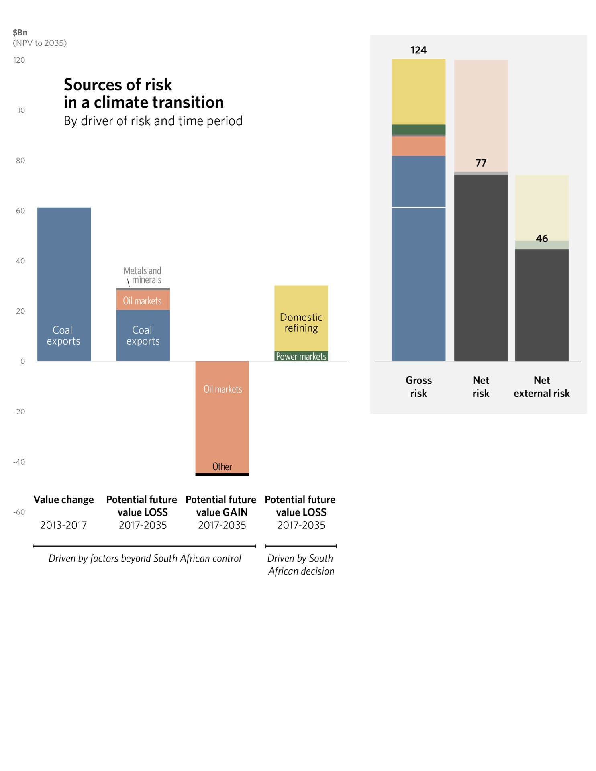
South Africa needs to respond to a global transition that is already underway
Questions for South Africa
on the transition
$bn
(NPV to 2035)
Sources of risk in a climate transition
By driver of risk and time period
60
What has already happened?
What could happen?
Are the drivers of transition impact global or domestic?
Who bears the risk and what can they do about it?
0
-60

Slide 9
The prospects for future South African exports have already collapsed over the last five years, but recognition of this within South Africa is inconsistent
Yearly demand for South African coal exports
(2018-2035)
Expected yearly net cash flows from South African
coal exports
(2018-2035)
mt
$Bn
BAU 2013 forecast
Expected value lost 2013 -2017
Due to changes in global expectations
Decline in future export volume expectations 2013 -2017
Due to changes in global expectations
Further decline in volume
under 2DS
BAU 2017 forecast
Further decline in value
under 2DS
Remaining value
2DS
Remaining volume 2DS
2 degrees

Slide 10
Falling coal exports will have knock-on impact on domestic rail, port and power infrastructure, creating potential tipping points
Current take or pay rail contracts are set to expire in 2026 – eroding Transnet freight profits but restoring value for struggling exporters
The entire rail line becomes uneconomic after 2032
Virtually no value left for Transnet after 2030

Slide 11
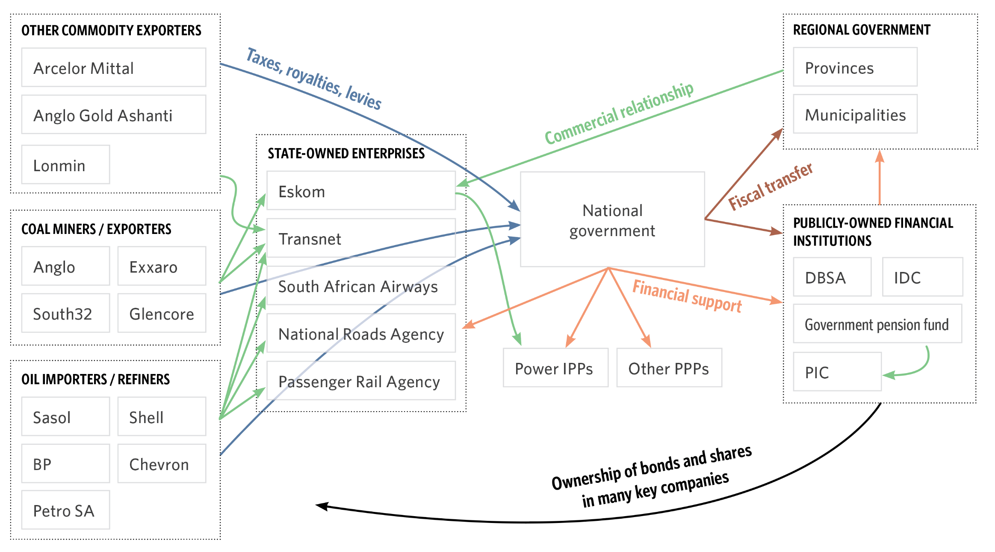
Ownership, financing and commercial relationships will determine how climate transition risk would be shared among various stakeholders
Linkages between public and private entities in South Africa

Slide 12
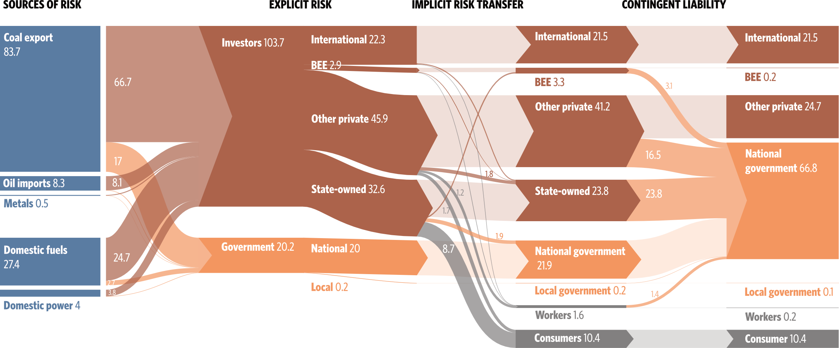
Risk will shift – often to the national government – as stakeholders respond to new realities

Slide 13
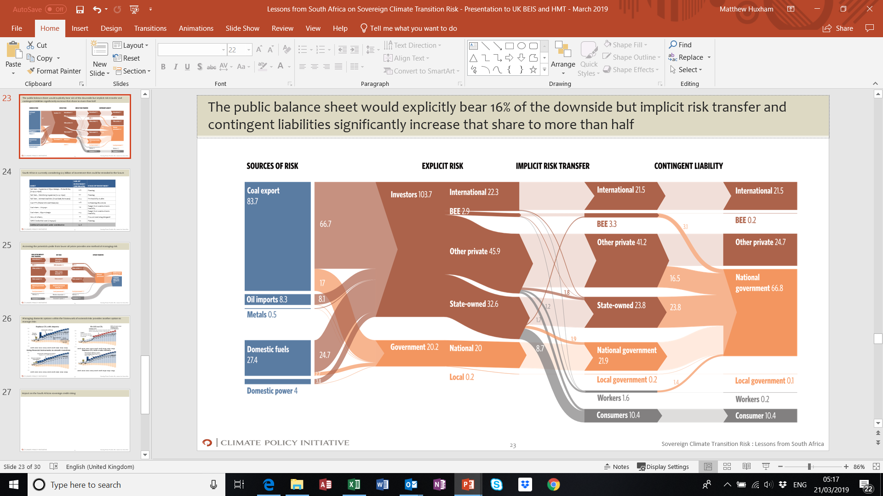
Transition risk, if not identified, monitored and managed, could hurt the South African sovereign credit rating and impact long term growth prospects and social outcomes
SA GDP 2017
SA loses investment grade credit rating?
$450 bn
Debt / GDP
70% (Brazil 2018, Ba2)
Weaker access to external credit
$307 bn
Transition risk
68% (SA 2017 + transition risk)
Higher borrowing costs
$240 bn
53% (SA 2017, Baa3)
Increased FX volatility
Public debt 2017
Impact on inflation
20% (SA govt target, National Development Plan)
Impact of transition risk on public balance sheet
Bailouts / financial support for firms and munis in distress
Additional debt guarantees for SOEs
Additional social spending
Transition risk could significantly increase public debt / GDP, a key metric for rating agencies
Timing and profile of risk is key
If transition risk not managed: weaker social and development outcomes, lower growth potential, increased social and political risk

Slide 14
The report contains a detailed set of recommended actions for South African policy makers…
Recommendations | Key actions
1. Take stock of the rapidly changing market for South African commodity exports and adapt development and financing plans accordingly. | Adopt a consistent approach to transition risk across South Africa Develop fiscal and financial tools to manage risk Consider capturing oil price windfall to offset and manage risks Consider publishing government transition risk analysis
2. Avoid or delay new investments that could add to South African climate transition risk exposure, until the market for the related product is certain. | Reconsider new investments that could add another $25.8 billion to transition Introduce climate transition risk assessments for access to public sector procurements Projects for reconsideration include planned IPPs, coal export rail, port infrastructure, and a new oil refinery
3. Make risk allocation explicit to reduce unmanaged risks and improve the efficiency of managing those risks. | Clarify responsibility for $38 billion of climate transition risk where the bearer of the risk is currently not explicit Develop and publish credible plans for managing these unallocated risks
4. Manage the timing and speed of climate mitigation actions and commitments to avoid compounding shocks to the economy. | Develop long term plans to manage the acceleration of transition risks in the early to mid 2020s Initiate scenario planning for early retirement of at-risk assets, including Eskom powerplants and Transnet rail lines Develop R&D plans to create new options, including CCS for Secunda
5. Plan for transitions to manage risk to vulnerable parts of the South African economy, such as workers and some investors. | Establish a transparent planning process for at-risk sectors, with earmarked transition funds and a gradual phase out Involve all interested groups in planning, including companies, trade unions, local governments, and the financial sector
6. Shift some risks from that national public balance sheet to other parties, possibly including sub-national governments, to increase risk bearing capacity. | Explore allocation of risks and revenues, particularly between different government levels, to maximize risk capacity Weigh options with respect to Eskom finances to manage potential contingent liability to national government
7. Work with international development finance institutions and other international financiers to address items 4, 5, and 6 within the international context | Work with international partners to balance global and South African risks and opportunities Seek assistance with financing solutions, underwriting, technical assistance, and potential carbon trades to leverage South African mitigation options

Slide 15
…which fall into three more broadly applicable categories
Countries need to be strategic in addressing transition risk
Continuous assessment of evolving transition risk
Time domestic transition policies within the scope of external risk
Plan for transition in advance (workers, industries, finance)
Make risk allocation explicit and provide the tools to manage the risk
2. Incorporate transition risk concentration as a key investment and policy measure
Ensure that new investment do not consume all available transition risk capacity for any party
Encourage rebalancing of risks through assets swaps and hedges
Shift risks to stakeholders with higher risk capacity and discourage asset sales that further concentrate risk
3. Seek to rebalance risks internationally
Transition risk as an opportunity for carbon markets and bilateral trades
Finance and technical assistance to help derisking in exposed countries

Slide 16
Even policies that are practically zero sum economy-wide, the distributional impacts still need managing
Accelerating a shift from coal power to renewables would increase costs modestly…
… but it would decrease domestic demand for coal
Coal demand by South African powerplants (2018-2035)
Environmental cost
Stranded asset
$4bn
Increase in power system costs
Potential change in domestic coal demand
Renewables cost
Coal commodity cost
BAU
2DS
Opex

Slide 17
Those that are more costly from a national perspective might be cost-effective from an international perspective
Secunda will continue to have high margins but will be more severely affected by lower global oil prices
The cost of phasing out Secunda will depend on the replacement
Stranded asset
BAU
Demolition
$27.4bn stranded from replacing CTL with imports
Coal to liquids refinery margins
New capex
Commodity cost
2DS
Crude refinery margins
Minimal change between scenarios
Opex
BAU

Slide 18




























We spoke to as many groups as we could throughout the process although there was some bias towards those groups predisposed to support the findings
Analytical coverage
Additional stakeholder engagement
Companies
State-owned financial institutions

Slide 19








Stakeholder engagement has, if anything, intensified following a successful launch
Media summary
Oped placed in Business Day ran on day of launch
Six news stories in South Africa national media – particularly good pick up in financial press, plus radio interview with David Nelson
Ongoing media engagement for thought leadership and op-ed placements, and global media outlets
Report launch
High level sponsorship of event from Development Bank of Southern Africa, including foreword and keynote from CEO and support from AFD, including foreword and remarks.
>80 attendees at launch event in Johannesburg, with senior representatives from national and regional government, state owned enterprises, private companies, banks and academia
Stakeholder programme
Bilaterals and deep dives with: Eskom; Transnet; Sasol; National Treasury; Exxaro; IDC and PIC
Presentation to Exxaro’s Lekgotla and invitation to present at board meeting in June
Meeting with NT’s financial stability team working on Eskom
Seminar for RSA govt departments date TBC

Slide 20
Scaling up the sovereign climate transition risk programme

Slide 21
Other major fossil fuel exporting countries will also face transition risks that are largely out of their control and should be targets for further analysis
CROSSOVER CREDITS STAND TO LOSE A LOT FROM EVEN A SMALL SHOCK
External exposure
(net emissions from exports,
MtCO2e)
Bubble size represents ratio of external exposure to size of economy MtCO2e/ GDP PPP
Aaa
Moody’s credit rating
C

Slide 22
Major consumers of coal in the power sector will face increased stranding risk as the costs of renewables and load factors of fossil power plants fall
Status of CPI transition risk work
China: Live discussions about provincial level case study
US: Several years of work completed
India: In early discussions
Japan: No discussions yet
South Korea: No discussions yet
Germany: No discussions but high think tank coverage
South Africa: Phase 1 complete
Australia: No discussions yet
Russia: No discussions yet
Indonesia: Project in planning
Others: No discussions yet – includes sources of growth in SE Asia (Vietnam, Malaysia, Thailand) and European laggards (Poland)

Slide 23
Wrap-up and key messages

Slide 24
Summary: sovereign climate transition risk is a new paradigm for using analysis to accelerate the low carbon transition that deserves scaling
Sovereign climate transition risk analysis…
…offers an alternative channel for influencing finance ministries, central banks and major investors beyond that of climate diplomacy and traditional advocacy campaigns
…frames domestic climate mitigation action as a means of hedging against short-to-medium term macroeconomic risks (rather than chasing longer-term benefits) and therefore as a means of protecting the social and other developmental gains of the last few decades
…creates an opportunity for building closer “inside track” links between international think tanks and local players (such as financial institutions) whose role in the transition is critical but who might otherwise be sceptical

Slide 25
We would be very interested to have further one-to-one conversations, including about potential collaborations, if any of the above has piqued your interest
Contact details:
Matthew Huxham. Principal, Energy Finance. Matthew.Huxham@cpilondon.org
David Nelson. Executive Director, Energy Finance. David@cpisf.org
Felicity Carus. Head of Communications, Energy Finance. Felicity.carus@cpilondon.org
Our South Africa report can be downloaded from: https://climatepolicyinitiative.org/publication/understanding-the-impact-of-a-low-carbon-transition-on-south-africa/

